Slide 1
Самые вкусные баги из игрового кода: как ошибаются наши коллеги-программисты
Докладчик:
Георгий Грибков

Slide 2

Георгий Грибков
Программист C++, разработчик статического анализатора кода
PVS-Studio
Автор статей и докладов о поиске ошибок в играх (Вангеры, VVVVVV)
и других проектах
с открытым исходным кодом
gribkov@viva64.com

Slide 3
Содержание
Как мы ищем ошибки в коде
Примеры и разбор найденных ошибок
Мысли напоследок

Slide 4
Как мы ищем ошибки в коде

Slide 5


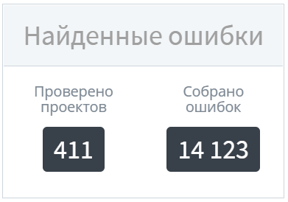
Как мы ищем ошибки в коде
Обновляемый список статей
о проверке проектов:

Slide 6
Примеры и разбор найденных ошибок

Slide 7
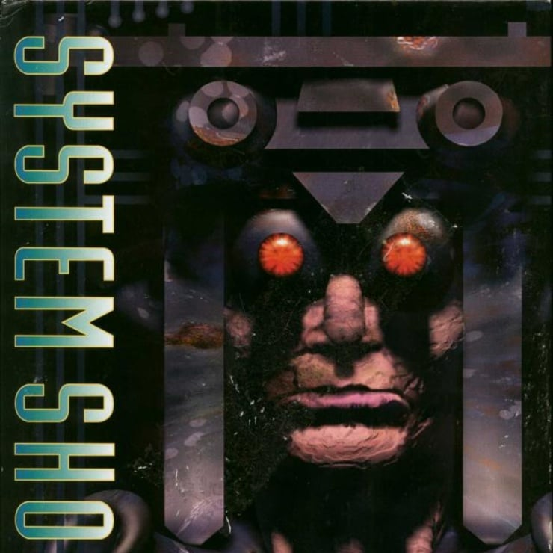
System Shock (Си)

Slide 8
Пример №1
fix Terrain( fix X, fix Y, int deriv ) {
if( deriv == 0 )
return fix_mul( fix_make(0,0x2000), (X - fix_make(20,0) ) );
if( deriv == 1 )
return fix_mul( fix_make(0,0x2000), (X - fix_make(20,0) ) );
if( deriv == 2 )
return 0;
return 0;
}

Slide 9
Пример №1
fix Terrain( fix X, fix Y, int deriv ) {
if( deriv == 0 )
return fix_mul( fix_make(0,0x2000), (X - fix_make(20,0) ) );
if( deriv == 1 )
return fix_mul( fix_make(0,0x2000), (X - fix_make(20,0) ) );
if( deriv == 2 )
return 0;
return 0;
}
V751 Parameter 'Y' is not used inside function body. BTEST.C 67

Slide 10
Пример №1
fix Terrain( fix X, fix Y, int deriv ) {
if( deriv == 0 )
return fix_mul( fix_make(0,0x2000), (X - fix_make(20,0) ) );
if( deriv == 1 )
return fix_mul( fix_make(0,0x2000), (Y - fix_make(20,0) ) );
if( deriv == 2 )
return 0;
return 0;
}
V751 Parameter 'Y' is not used inside function body. BTEST.C 67

Slide 11
Забавные комментарии
// And here, ladies and gentlemen,
// is a celebration of C and C++ and their untamed passion...
// ==================
TerrainData terrain_info;
// Now the actual stuff...
// =======================

Slide 12
Забавные комментарии
// it's a wonderful world, with a lot of strange men
// who are standing around, and they all wearing towels
// Returns whether or not in the humble opinion of the
// sound system, the sample should be politely
// obliterated out of existence

Slide 13

Space
Engineers (C#)

Slide 14
Пример №1
if (....)
MySandboxGame.Log.WriteLine(string.Format(
"Could not find any sound for '{0}'", cueName));
else
{
if (....)
string.Format(
"Could not find arcade sound for '{0}'", cueName);
if (....)
string.Format(
"Could not find realistic sound for '{0}'", cueName);
}

Slide 15
Пример №1
if (....)
MySandboxGame.Log.WriteLine(string.Format(
"Could not find any sound for '{0}'", cueName));
else
{
if (....)
string.Format(
"Could not find arcade sound for '{0}'", cueName);
if (....)
string.Format(
"Could not find realistic sound for '{0}'", cueName);
}
V3010 The return value of function 'Format' is required to be utilized. Sandbox.Game MyEntity3DSoundEmitter.cs 72, 74

Slide 16
Пример №1
if (....)
MySandboxGame.Log.WriteLine(string.Format(
"Could not find any sound for '{0}'", cueName));
else
{
if (....)
MySandboxGame.Log.WriteLine(string.Format(
"Could not find arcade sound for '{0}'", cueName));
if (....)
MySandboxGame.Log.WriteLine(string.Format(
"Could not find realistic sound for '{0}'", cueName));
}
V3010 The return value of function 'Format' is required to be utilized. Sandbox.Game MyEntity3DSoundEmitter.cs 72, 74

Slide 17
Пример №2
var actionsItem = item as MyToolbarItemActions;
if (item != null)
{
if (idx < 0 || idx >= actionsItem
.PossibleActions(....)
.Count)
RemoveToolbarItem(slot);
....
}

Slide 18
Пример №2
var actionsItem = item as MyToolbarItemActions;
if (item != null)
{
if (idx < 0 || idx >= actionsItem
.PossibleActions(....)
.Count)
RemoveToolbarItem(slot);
....
}
V3019 Possibly an incorrect variable is compared to null after type conversion using 'as' keyword. Check variables 'item', 'actionsItem'. Sandbox.Game MyGuiControlToolbar.cs 511

Slide 19
Пример №2
var actionsItem = item as MyToolbarItemActions;
if (item != null)
{
if (idx < 0 || idx >= actionsItem
.PossibleActions(....)
.Count)
RemoveToolbarItem(slot);
....
}
V3019 Possibly an incorrect variable is compared to null after type conversion using 'as' keyword. Check variables 'item', 'actionsItem'. Sandbox.Game MyGuiControlToolbar.cs 511

Slide 20
Пример №2
var actionsItem = item as MyToolbarItemActions;
if (actionsItem != null)
{
if (idx < 0 || idx >= actionsItem
.PossibleActions(....)
.Count)
RemoveToolbarItem(slot);
....
}
V3019 Possibly an incorrect variable is compared to null after type conversion using 'as' keyword. Check variables 'item', 'actionsItem'. Sandbox.Game MyGuiControlToolbar.cs 511

Slide 21

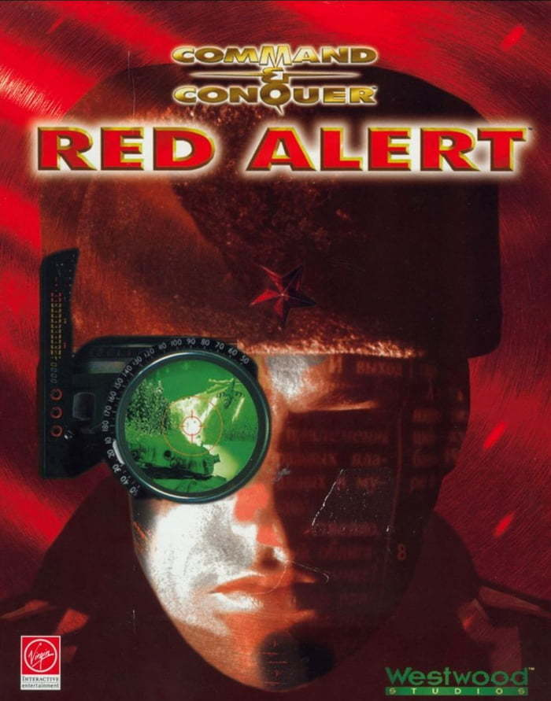
C&C: Tiberian Dawn и C&C: Red Alert (C++)

Slide 22
Пример №1
// Maximum number of multi players possible.
#define MAX_PLAYERS 8 // max # of players we can have
for (int i = 0; i < MAX_PLAYERS && i < 4; i++) {
if (GlyphxPlayerIDs[i] == player_id) {
MultiplayerStartPositions[i] = XY_Cell(x, y);
}
}

Slide 23
Пример №1
// Maximum number of multi players possible.
#define MAX_PLAYERS 8 // max # of players we can have
for (int i = 0; i < MAX_PLAYERS && i < 4; i++) {
if (GlyphxPlayerIDs[i] == player_id) {
MultiplayerStartPositions[i] = XY_Cell(x, y);
}
}
V590 Consider inspecting the 'i < 8 && i < 4' expression. The expression is excessive or contains a misprint. DLLInterface.cpp 2238

Slide 24
Пример №1
// Maximum number of multi players possible.
#define MAX_PLAYERS 8 // max # of players we can have
for (int i = 0; i < MAX_PLAYERS || i < 4; i++) {
if (GlyphxPlayerIDs[i] == player_id) {
MultiplayerStartPositions[i] = XY_Cell(x, y);
}
}
V590 Consider inspecting the 'i < 8 && i < 4' expression. The expression is excessive or contains a misprint. DLLInterface.cpp 2238

Slide 25
Пример №2
void * ptr = new char [sizeof(100)];
if (ptr) {
sprintf((char *)ptr,
"%cTrack %d\t%d:%02d\t%s",
....);
listbox.Add_Item((char const *)ptr);
}

Slide 26
Пример №2
void * ptr = new char [sizeof(100)];
if (ptr) {
sprintf((char *)ptr,
"%cTrack %d\t%d:%02d\t%s",
....);
listbox.Add_Item((char const *)ptr);
}
V512 A call of the 'sprintf' function will lead to overflow of the buffer '(char *) ptr'. SOUNDDLG.CPP 250

Slide 27
Пример №2
void * ptr = new char [100];
if (ptr) {
sprintf((char *)ptr,
"%cTrack %d\t%d:%02d\t%s",
....);
listbox.Add_Item((char const *)ptr);
}
V512 A call of the 'sprintf' function will lead to overflow of the buffer '(char *) ptr'. SOUNDDLG.CPP 250

Slide 28
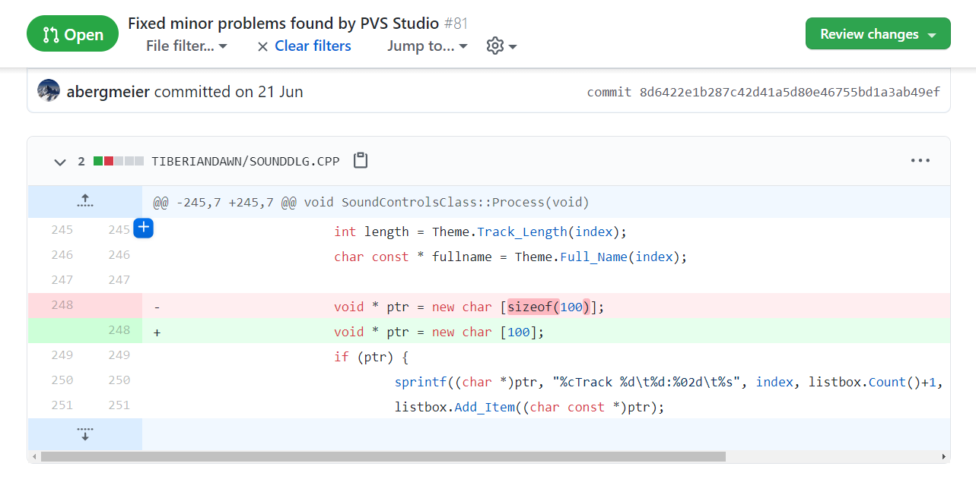

Slide 29

Doom 3 (C++)

Slide 30
Пример №1
for ( j = 0; j < w.GetNumPoints(); j++ ) {
for ( k = 0; k < verts.Num(); j++ ) {
if ( verts[k].xyz.Compare(w[j].ToVec3(),
POLYTOPE_VERTEX_EPSILON))
{
break;
}
}
...
}

Slide 31
Пример №1
for ( j = 0; j < w.GetNumPoints(); j++ ) {
for ( k = 0; k < verts.Num(); j++ ) {
if ( verts[k].xyz.Compare(w[j].ToVec3(),
POLYTOPE_VERTEX_EPSILON))
{
break;
}
}
...
}
V533 It is likely that a wrong variable is being incremented inside the 'for' operator. Consider reviewing 'j'. idLib surface_polytope.cpp 65

Slide 32
Пример №1
for ( j = 0; j < w.GetNumPoints(); j++ ) {
for ( k = 0; k < verts.Num(); k++ ) {
if ( verts[k].xyz.Compare(w[j].ToVec3(),
POLYTOPE_VERTEX_EPSILON))
{
break;
}
}
...
}
V533 It is likely that a wrong variable is being incremented inside the 'for' operator. Consider reviewing 'j'. idLib surface_polytope.cpp 65

Slide 33
Пример №2
void idBrushBSP::FloodThroughPortals_r
(idBrushBSPNode *node, ...)
{
...
if ( node->occupied ) {
common->Error( "Node already occupied\n" );
}
if ( !node ) {
common->Error( "NULL node\n" );
}
...
}

Slide 34
Пример №2
void idBrushBSP::FloodThroughPortals_r
(idBrushBSPNode *node, ...)
{
...
if ( node->occupied ) {
common->Error( "Node already occupied\n" );
}
if ( !node ) {
common->Error( "NULL node\n" );
}
...
}
V595 The 'node' pointer was utilized before it was verified against nullptr. Check lines: 1421, 1424. DoomDLL brushbsp.cpp 1421

Slide 35
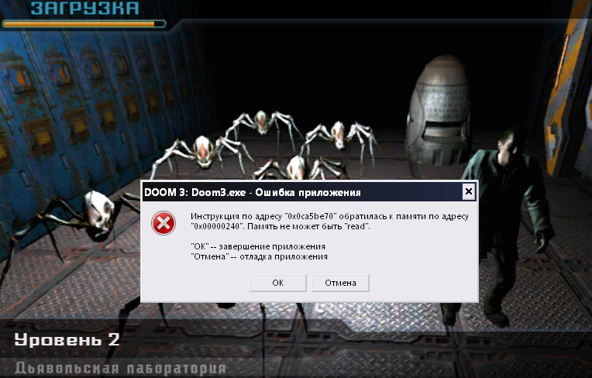
Пример №2

Slide 36
Пример №2
void idBrushBSP::FloodThroughPortals_r
(idBrushBSPNode *node, ...)
{
...
if ( node->occupied ) {
common->Error( "Node already occupied\n" );
}
if ( !node ) {
common->Error( "NULL node\n" );
}
...
}
V595 The 'node' pointer was utilized before it was verified against nullptr. Check lines: 1421, 1424. DoomDLL brushbsp.cpp 1421

Slide 37
Пример №2
void idBrushBSP::FloodThroughPortals_r
(idBrushBSPNode *node, ...)
{
...
if ( !node ) {
common->Error( "NULL node\n" );
}
if ( node->occupied ) {
common->Error( "Node already occupied\n" );
}
...
}
V595 The 'node' pointer was utilized before it was verified against nullptr. Check lines: 1421, 1424. DoomDLL brushbsp.cpp 1421

Slide 38

osu! (C#)

Slide 39
Пример №1
public RulesetInfo GetRuleset(int id) =>
AvailableRulesets.FirstOrDefault(....);
....
public ScoreInfo CreateScoreInfo(RulesetStore rulesets) {
var ruleset = rulesets.GetRuleset(OnlineRulesetID);
var mods =
Mods != null
? ruleset.CreateInstance().GetAllMods().Where(....).ToArray()
: Array.Empty<Mod>();
....
}

Slide 40
Пример №1
public RulesetInfo GetRuleset(int id) =>
AvailableRulesets.FirstOrDefault(....);
....
public ScoreInfo CreateScoreInfo(RulesetStore rulesets) {
var ruleset = rulesets.GetRuleset(OnlineRulesetID);
var mods =
Mods != null
? ruleset.CreateInstance().GetAllMods().Where(....).ToArray()
: Array.Empty<Mod>();
....
}
V3146 Possible null dereference of 'ruleset'. The 'FirstOrDefault' can return default null value. APILegacyScoreInfo.cs 24

Slide 41
Пример №1
public RulesetInfo GetRuleset(int id) =>
AvailableRulesets.FirstOrDefault(....);
....
public ScoreInfo CreateScoreInfo(RulesetStore rulesets) {
var ruleset = rulesets.GetRuleset(OnlineRulesetID);
var mods =
(Mods != null && ruleset != null)
? ruleset.CreateInstance().GetAllMods().Where(....).ToArray()
: Array.Empty<Mod>();
....
}
V3146 Possible null dereference of 'ruleset'. The 'FirstOrDefault' can return default null value. APILegacyScoreInfo.cs 24

Slide 42
Пример №2
private void onScreenChange(IScreen prev, IScreen next)
{
parallaxContainer.ParallaxAmount =
ParallaxContainer.DEFAULT_PARALLAX_AMOUNT *
((IOsuScreen)next)?.BackgroundParallaxAmount ?? 1.0f;
}

Slide 43
Пример №2
private void onScreenChange(IScreen prev, IScreen next)
{
parallaxContainer.ParallaxAmount =
ParallaxContainer.DEFAULT_PARALLAX_AMOUNT *
((IOsuScreen)next)?.BackgroundParallaxAmount ?? 1.0f;
}
V3123 Perhaps the '??' operator works in a different way than it was expected. Its priority is lower than priority of other operators in its left part. OsuScreenStack.cs 45

Slide 44
Пример №2
private void onScreenChange(IScreen prev, IScreen next)
{
parallaxContainer.ParallaxAmount =
ParallaxContainer.DEFAULT_PARALLAX_AMOUNT *
((IOsuScreen)next)?.BackgroundParallaxAmount ?? 1.0f;
}
V3123 Perhaps the '??' operator works in a different way than it was expected. Its priority is lower than priority of other operators in its left part. OsuScreenStack.cs 45

Slide 45
Пример №2
private void onScreenChange(IScreen prev, IScreen next)
{
parallaxContainer.ParallaxAmount =
ParallaxContainer.DEFAULT_PARALLAX_AMOUNT *
((IOsuScreen)next)?.BackgroundParallaxAmount ?? 1.0f;
}
V3123 Perhaps the '??' operator works in a different way than it was expected. Its priority is lower than priority of other operators in its left part. OsuScreenStack.cs 45

Slide 46
Пример №2
private void onScreenChange(IScreen prev, IScreen next)
{
parallaxContainer.ParallaxAmount =
ParallaxContainer.DEFAULT_PARALLAX_AMOUNT *
((IOsuScreen)next)?.BackgroundParallaxAmount ?? 1.0f;
}
x = (c * a) ?? b;
V3123 Perhaps the '??' operator works in a different way than it was expected. Its priority is lower than priority of other operators in its left part. OsuScreenStack.cs 45

Slide 47
Пример №2
Что, если ((IOsuScreen)next) окажется null?

Slide 48
Пример №2
private void onScreenChange(IScreen prev, IScreen next)
{
parallaxContainer.ParallaxAmount =
ParallaxContainer.DEFAULT_PARALLAX_AMOUNT *
((IOsuScreen)next)?.BackgroundParallaxAmount ?? 1.0f;
}
x = (c * a) ?? b;
V3123 Perhaps the '??' operator works in a different way than it was expected. Its priority is lower than priority of other operators in its left part. OsuScreenStack.cs 45

Slide 49
Пример №2
private void onScreenChange(IScreen prev, IScreen next)
{
parallaxContainer.ParallaxAmount =
ParallaxContainer.DEFAULT_PARALLAX_AMOUNT *
(null)?.BackgroundParallaxAmount ?? 1.0f;
}
x = (c * a) ?? b;
V3123 Perhaps the '??' operator works in a different way than it was expected. Its priority is lower than priority of other operators in its left part. OsuScreenStack.cs 45

Slide 50
Пример №2
private void onScreenChange(IScreen prev, IScreen next)
{
parallaxContainer.ParallaxAmount =
ParallaxContainer.DEFAULT_PARALLAX_AMOUNT *
null ?? 1.0f;
}
x = (c * null) ?? b;
V3123 Perhaps the '??' operator works in a different way than it was expected. Its priority is lower than priority of other operators in its left part. OsuScreenStack.cs 45

Slide 51
Пример №2
private void onScreenChange(IScreen prev, IScreen next)
{
parallaxContainer.ParallaxAmount =
null
?? 1.0f;
}
x = null ?? b;
V3123 Perhaps the '??' operator works in a different way than it was expected. Its priority is lower than priority of other operators in its left part. OsuScreenStack.cs 45

Slide 52
Пример №2
private void onScreenChange(IScreen prev, IScreen next)
{
parallaxContainer.ParallaxAmount = 1.0f;
}
x = b;
V3123 Perhaps the '??' operator works in a different way than it was expected. Its priority is lower than priority of other operators in its left part. OsuScreenStack.cs 45

Slide 53
Пример №2
Это ошибка!!!

Slide 54
Пример №2
private void onScreenChange(IScreen prev, IScreen next)
{
parallaxContainer.ParallaxAmount =
ParallaxContainer.DEFAULT_PARALLAX_AMOUNT *
((IOsuScreen)next)?.BackgroundParallaxAmount ?? 1.0f;
}
V3123 Perhaps the '??' operator works in a different way than it was expected. Its priority is lower than priority of other operators in its left part. OsuScreenStack.cs 45

Slide 55
Пример №2
private void onScreenChange(IScreen prev, IScreen next)
{
parallaxContainer.ParallaxAmount =
ParallaxContainer.DEFAULT_PARALLAX_AMOUNT *
(((IOsuScreen)next)?.BackgroundParallaxAmount ?? 1.0f);
}
x = c * (a ?? b);
V3123 Perhaps the '??' operator works in a different way than it was expected. Its priority is lower than priority of other operators in its left part. OsuScreenStack.cs 45

Slide 56
Пример №2
private void onScreenChange(IScreen prev, IScreen next)
{
parallaxContainer.ParallaxAmount =
ParallaxContainer.DEFAULT_PARALLAX_AMOUNT *
(null?.BackgroundParallaxAmount ?? 1.0f);
}
x = c * (a ?? b);
V3123 Perhaps the '??' operator works in a different way than it was expected. Its priority is lower than priority of other operators in its left part. OsuScreenStack.cs 45

Slide 57
Пример №2
private void onScreenChange(IScreen prev, IScreen next)
{
parallaxContainer.ParallaxAmount =
ParallaxContainer.DEFAULT_PARALLAX_AMOUNT *
(null ?? 1.0f);
}
x = c * (null ?? b);
V3123 Perhaps the '??' operator works in a different way than it was expected. Its priority is lower than priority of other operators in its left part. OsuScreenStack.cs 45

Slide 58
Пример №2
private void onScreenChange(IScreen prev, IScreen next)
{
parallaxContainer.ParallaxAmount =
ParallaxContainer.DEFAULT_PARALLAX_AMOUNT * 1.0f;
}
x = c * b;
V3123 Perhaps the '??' operator works in a different way than it was expected. Its priority is lower than priority of other operators in its left part. OsuScreenStack.cs 45

Slide 59
Пример №2
private void onScreenChange(IScreen prev, IScreen next)
{
parallaxContainer.ParallaxAmount =
ParallaxContainer.DEFAULT_PARALLAX_AMOUNT;
}
x = c * b;
V3123 Perhaps the '??' operator works in a different way than it was expected. Its priority is lower than priority of other operators in its left part. OsuScreenStack.cs 45

Slide 60

VVVVVV (C++)

Slide 61
Пример №1
TiXmlElement *pElem;
....
pElem = hDoc.FirstChildElement().Element();
if (!pElem)
{
printf("No valid root! Corrupt level file?\n");
}
pElem->QueryIntAttribute("version", &version);

Slide 62
Пример №1
TiXmlElement *pElem;
....
pElem = hDoc.FirstChildElement().Element();
if (!pElem)
{
printf("No valid root! Corrupt level file?\n");
}
pElem->QueryIntAttribute("version", &version);
V1004 The 'pElem' pointer was used unsafely after it was verified against nullptr. Check lines: 1739, 1744. editor.cpp 1744

Slide 63
Пример №1
TiXmlElement *pElem;
....
pElem = hDoc.FirstChildElement().Element();
if (!pElem)
{
printf("No valid root! Corrupt level file?\n");
return;
}
pElem->QueryIntAttribute("version", &version);
V1004 The 'pElem' pointer was used unsafely after it was verified against nullptr. Check lines: 1739, 1744. editor.cpp 1744

Slide 64
Пример №1
TiXmlElement *pElem;
....
pElem = hDoc.FirstChildElement().Element();
if (!pElem)
{
printf("No valid root! Corrupt level file?\n");
return; // Также можно было сделать throw
}
pElem->QueryIntAttribute("version", &version);
V1004 The 'pElem' pointer was used unsafely after it was verified against nullptr. Check lines: 1739, 1744. editor.cpp 1744

Slide 65
Адский switch
V2008 Cyclomatic complexity: 548. Consider refactoring the 'Game::updatestate' function. Game.cpp 612

Slide 66
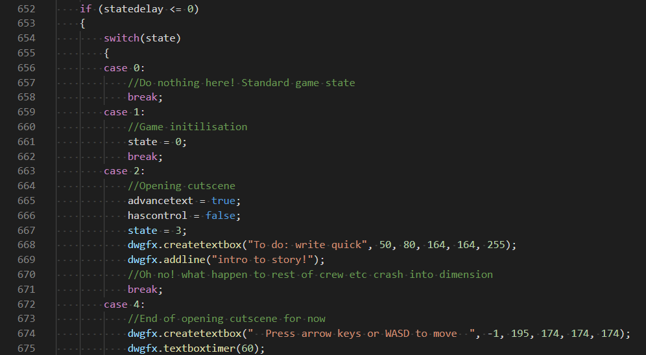
Адский switch

Slide 67
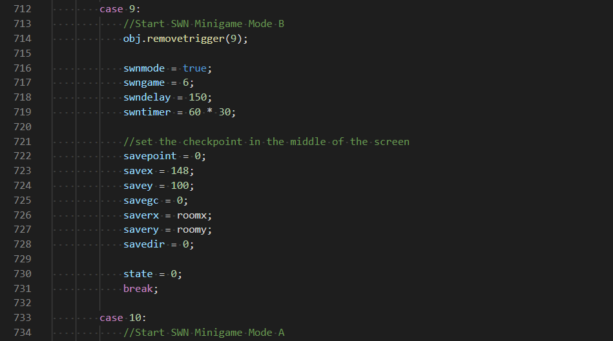
Адский switch

Slide 68
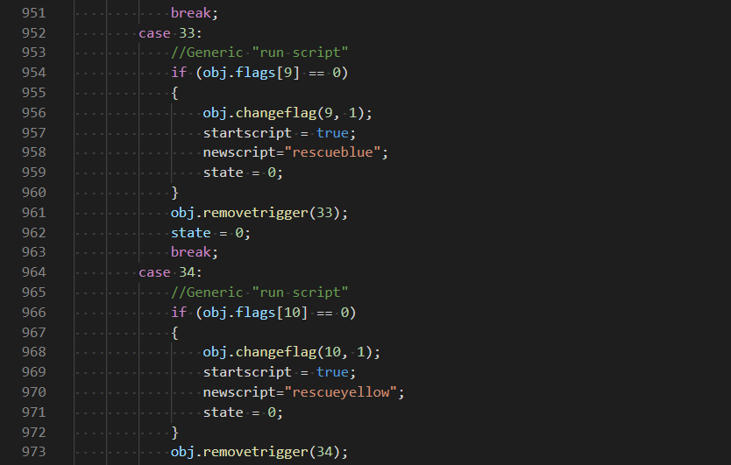
Адский switch

Slide 69
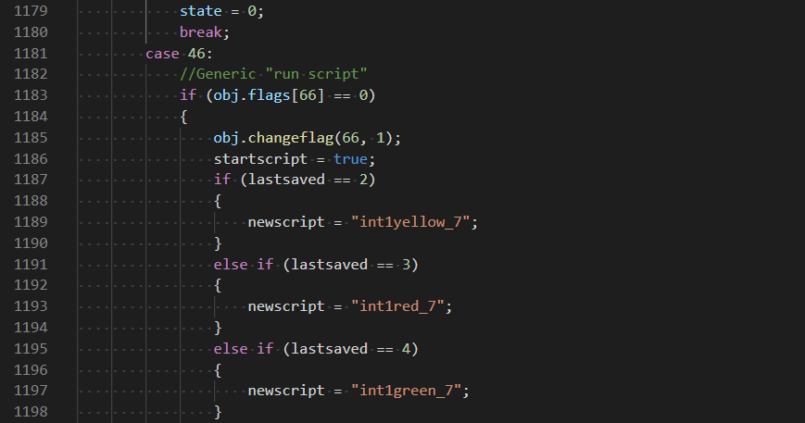
Адский switch

Slide 70
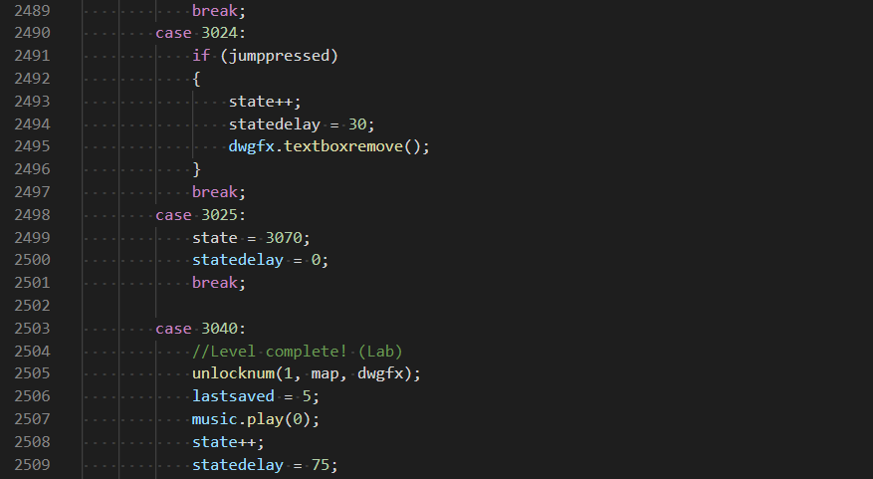
Адский switch

Slide 71
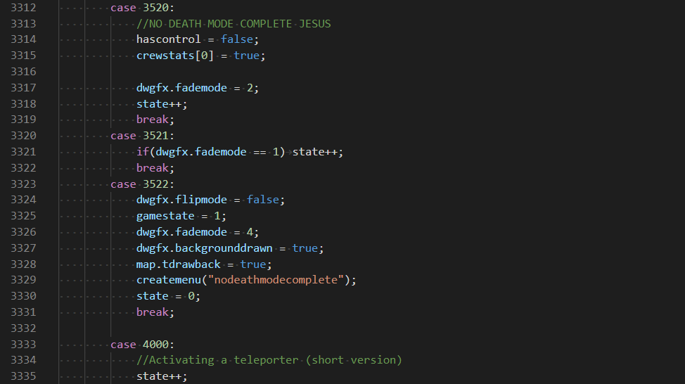
Адский switch

Slide 72
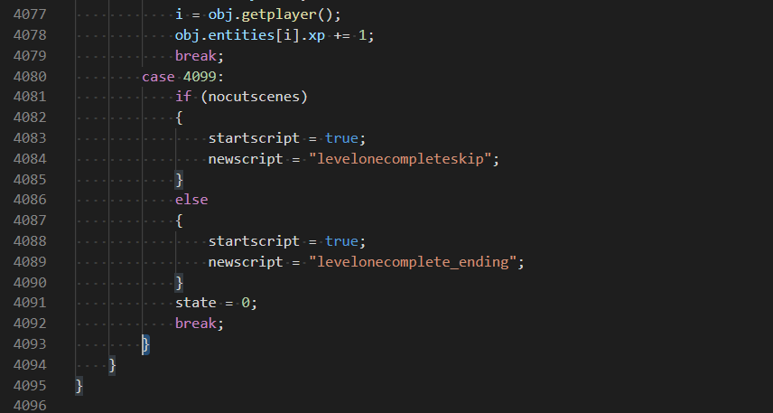
Адский switch

Slide 73
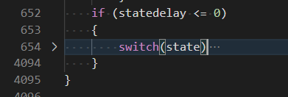
Адский switch
3339 строк
Около 300 case-ветвей
Ни одной enum-константы

Slide 74
Мысли напоследок

Slide 75
Мысли напоследок
Всех ошибок можно было избежать, используя статический анализ кода
Показанные примеры – лишь вершина айсберга

Slide 76
Кто уже использует статический анализ
id Software
Wargaming
Epic Games
Playrix
Warner Brothers
Oculus
Codemasters
Rocksteady
ZeniMax Media
И другие…

Slide 77


Бесплатная лицензия
для open-source проектов:
Промокод на месяц:
www.viva64.com/pvs-free-opensource
www.viva64.com/download-devgamm

